Slide 1
One hidden layer
Neural Network
Neural Networks
Overview

Slide 2
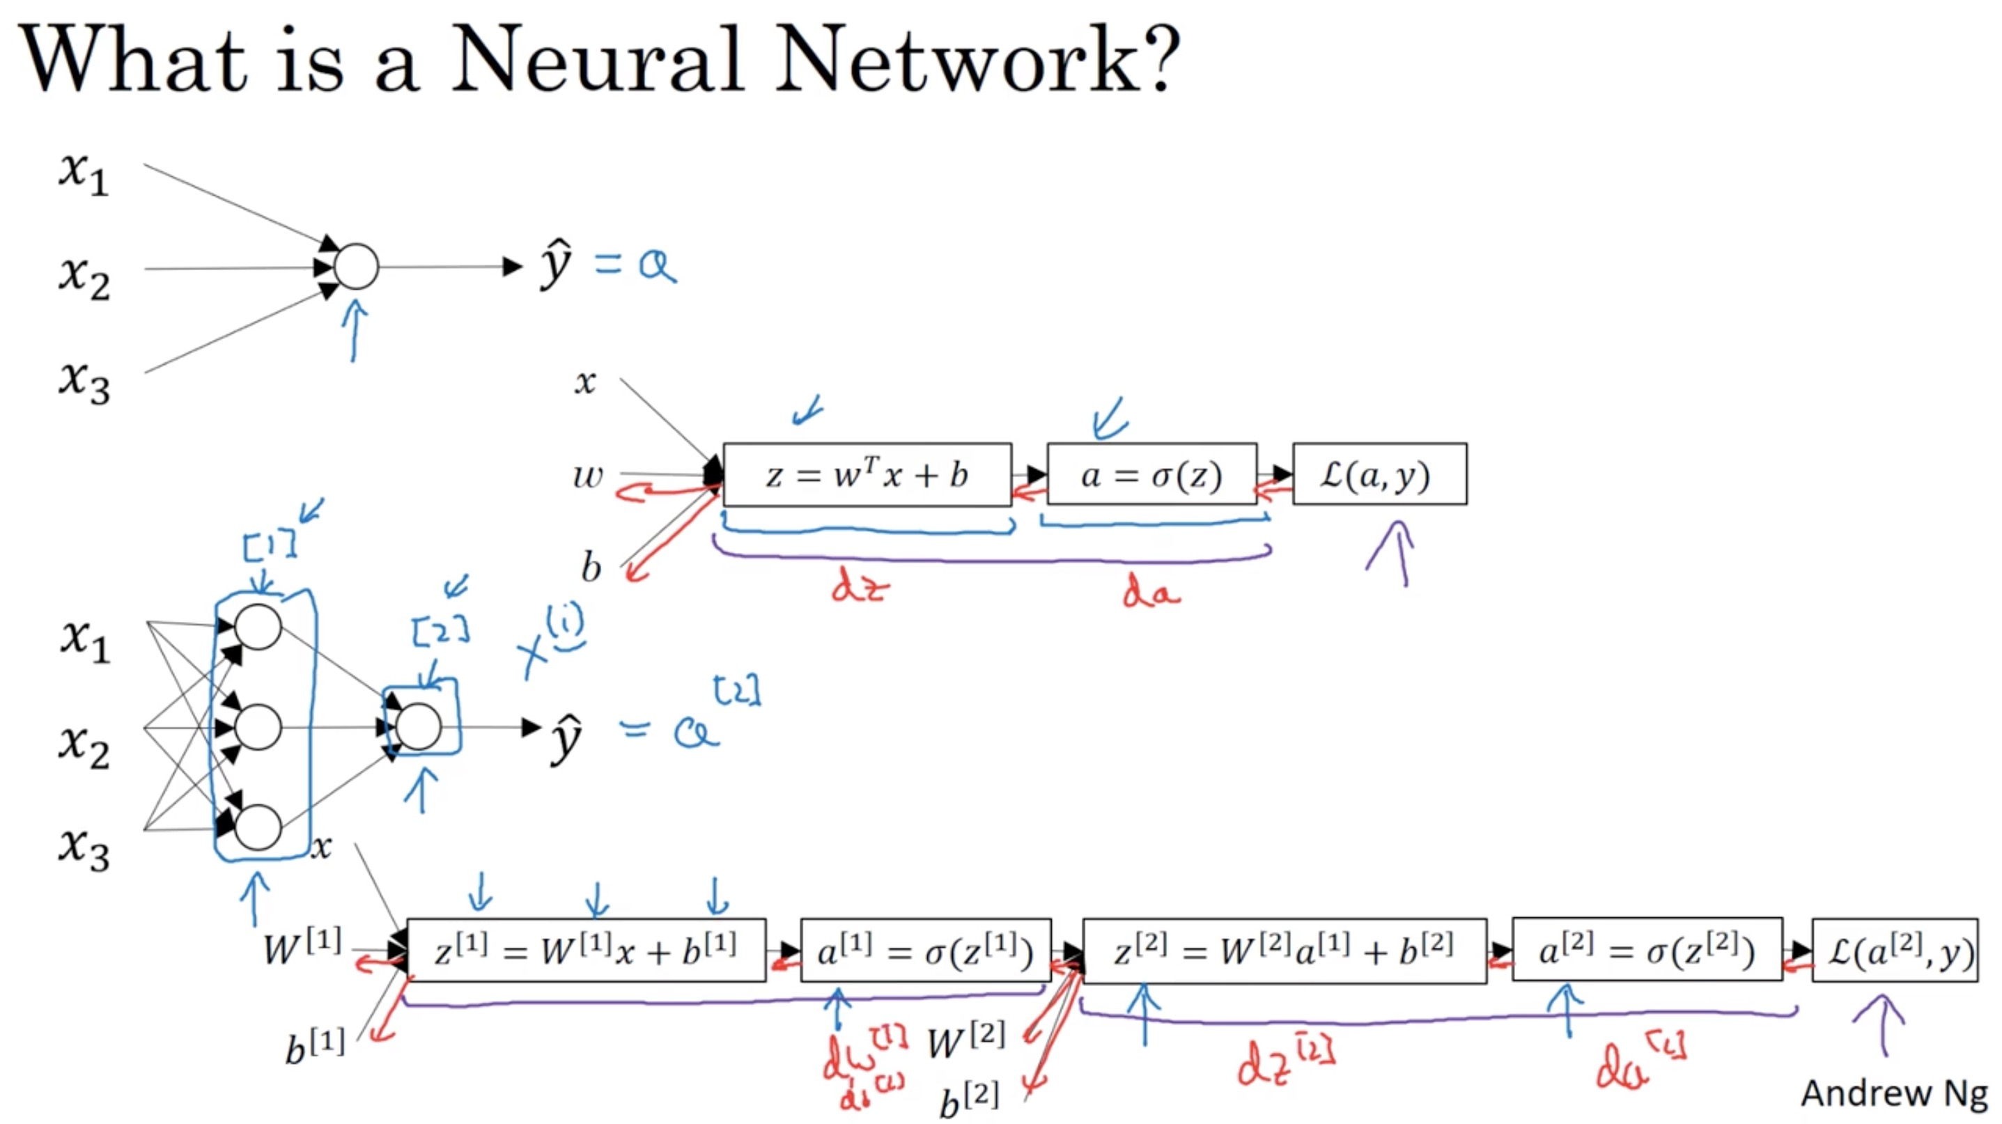

Slide 3
One hidden layer
Neural Network
Neural Network
Representation

Slide 4
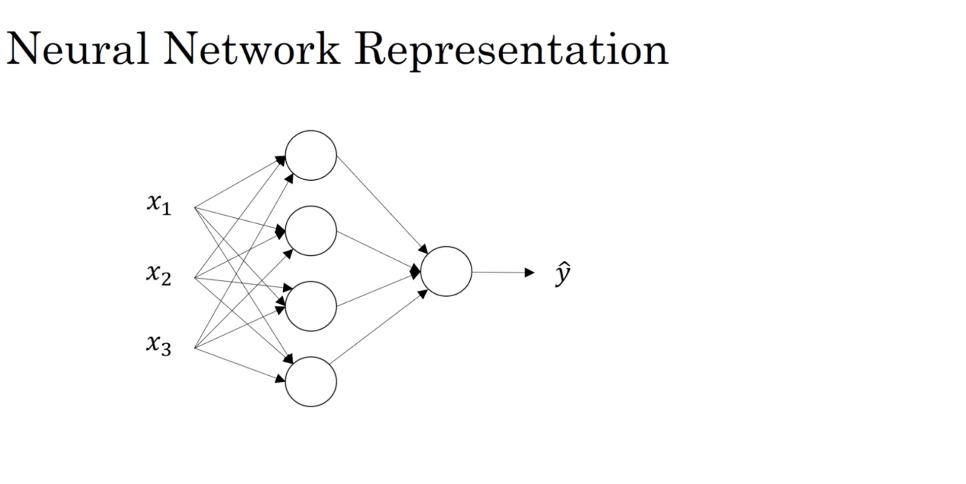

Slide 5
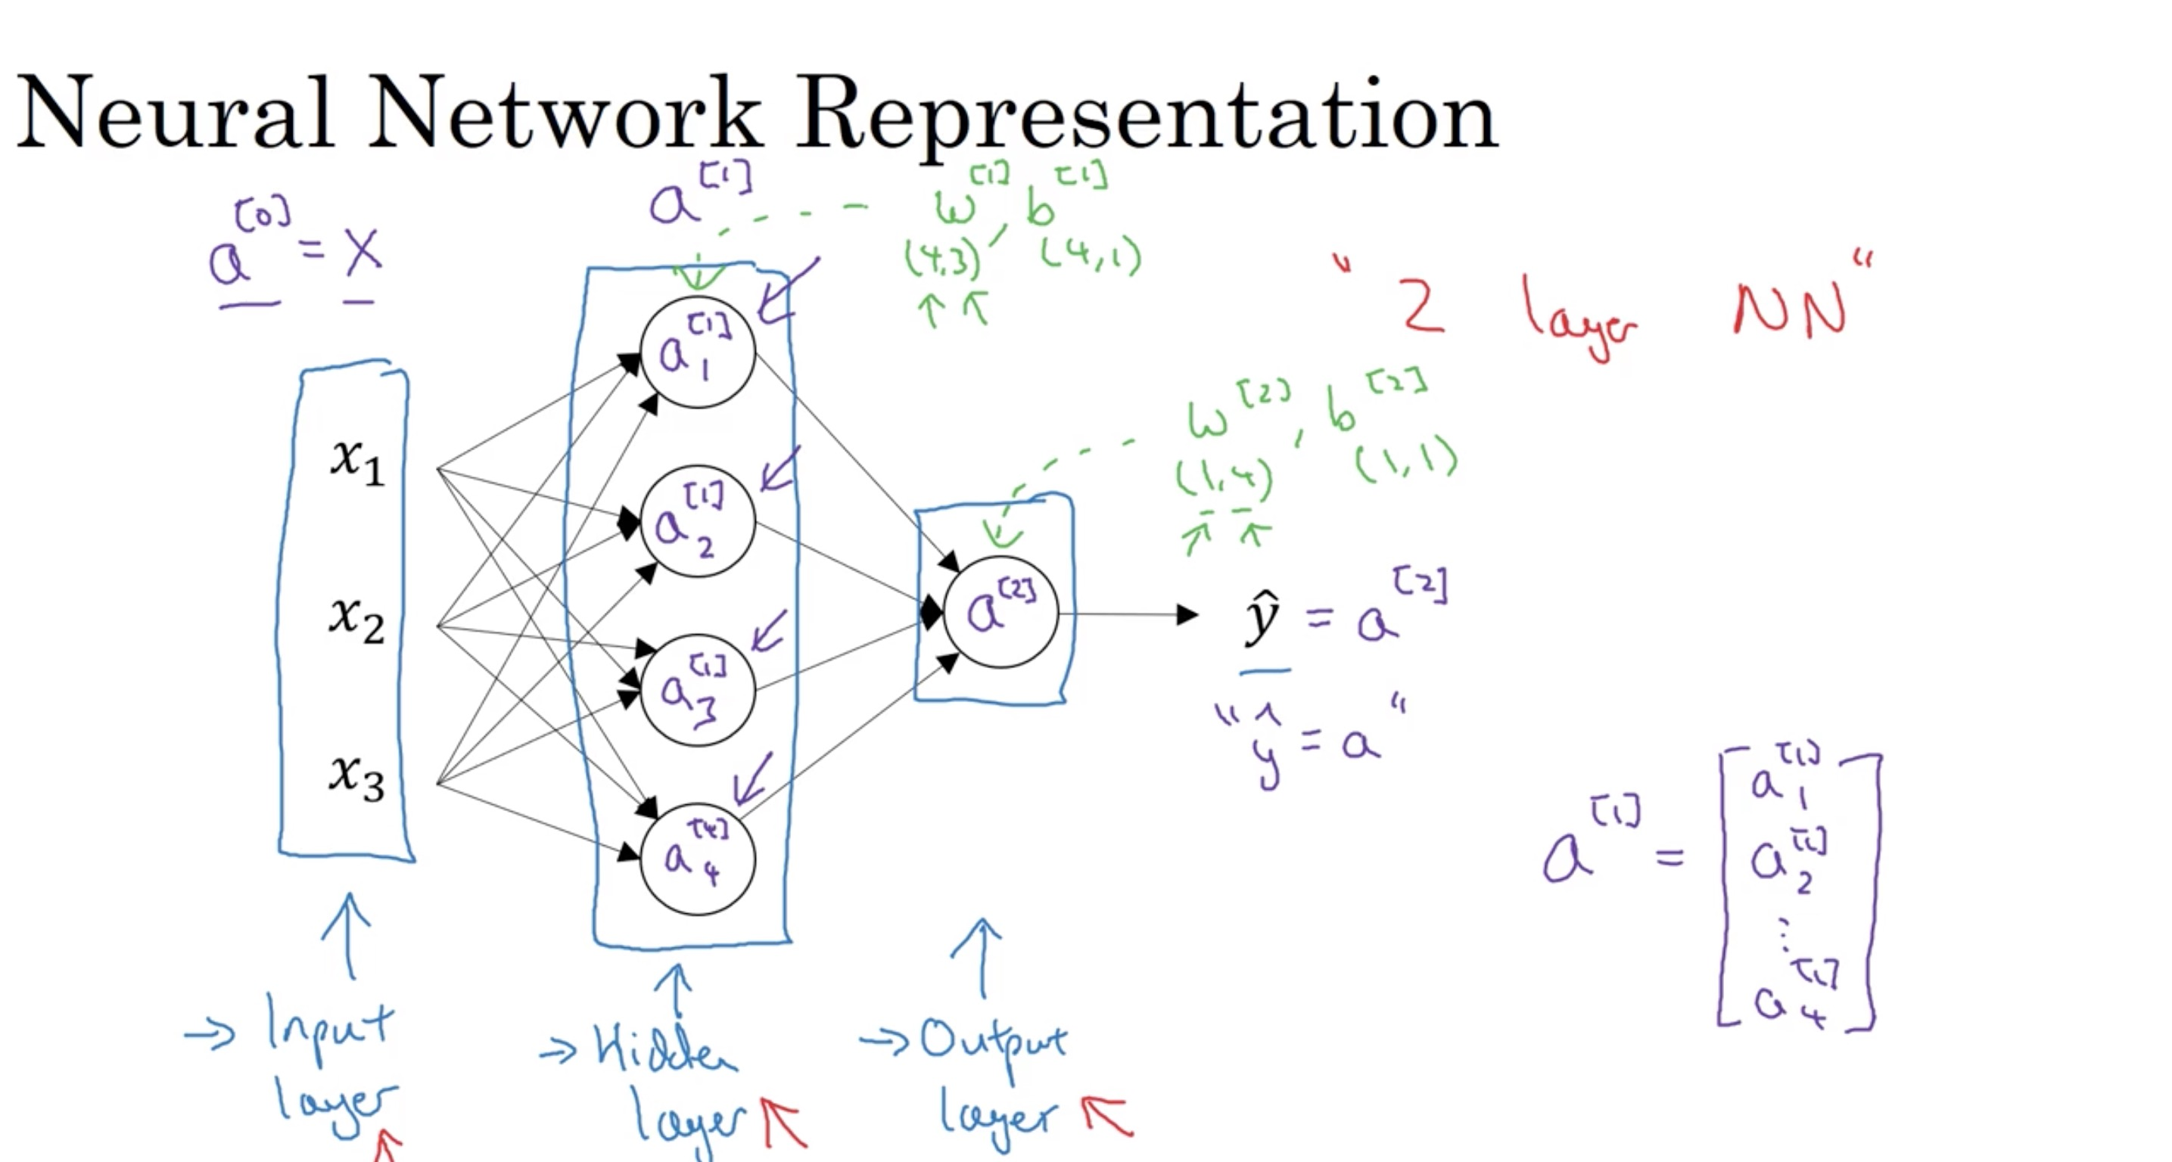

Slide 6
One hidden layer
Neural Network
Computing a
Neural Network’s
Output

Slide 7
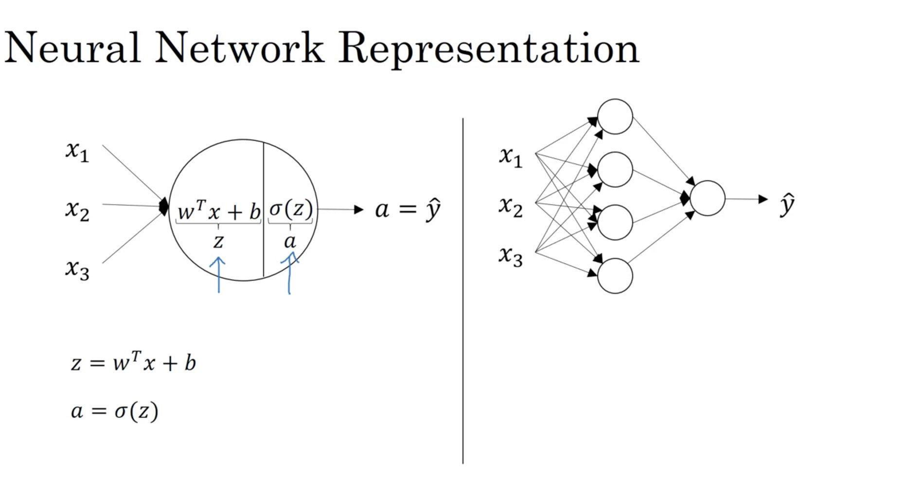

Slide 8
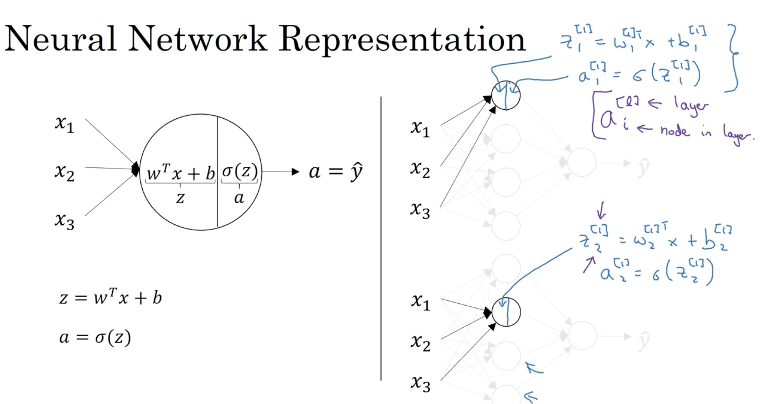

Slide 9
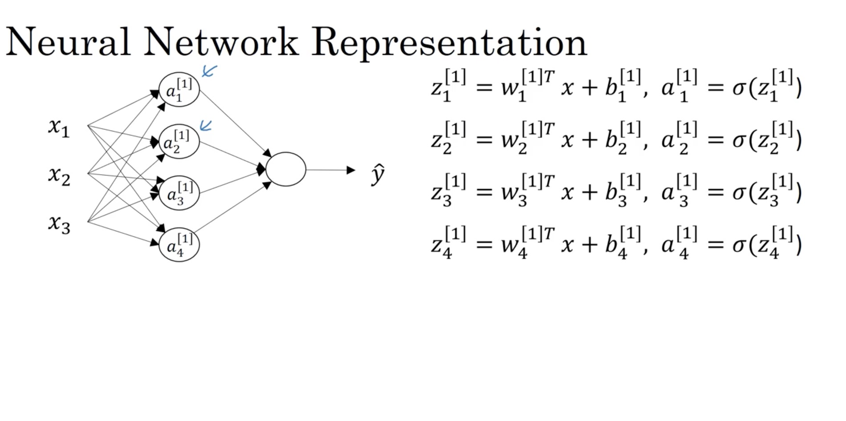

Slide 10
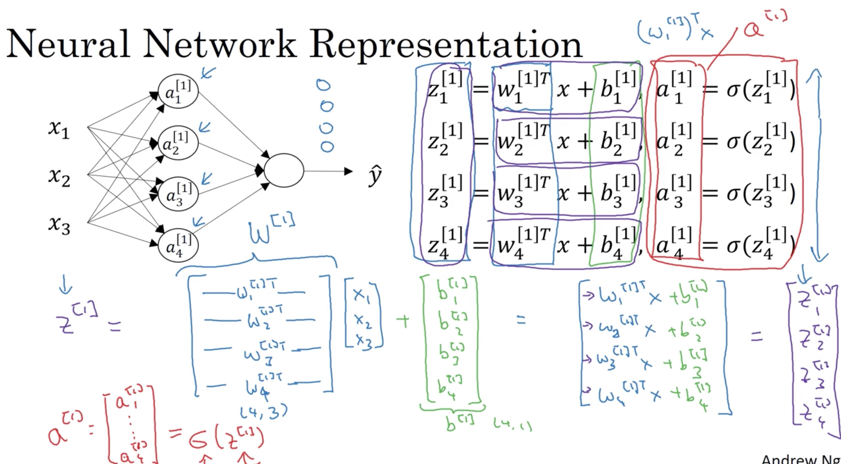

Slide 11
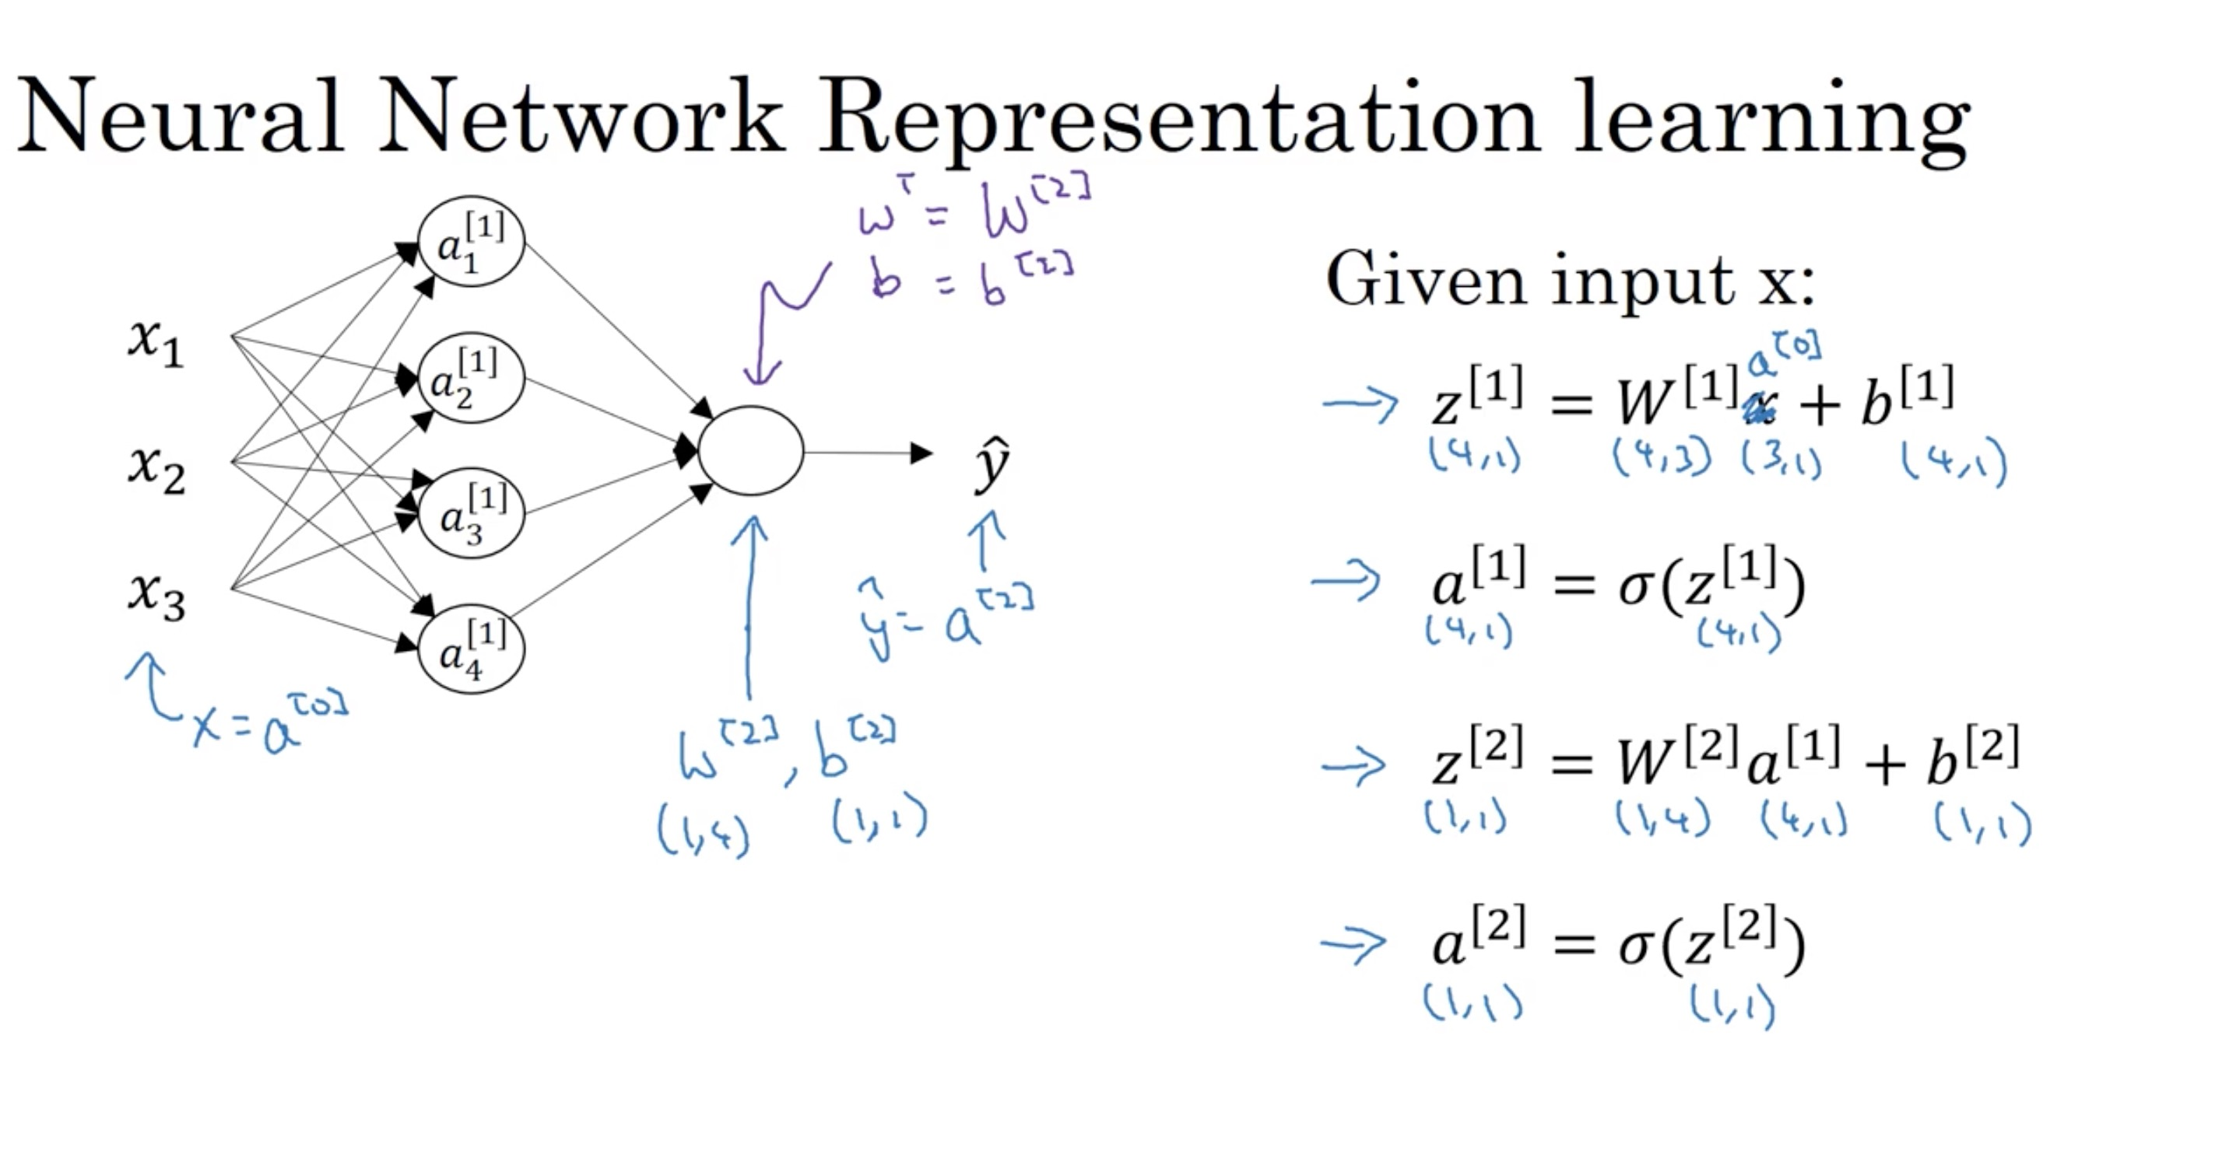

Slide 12
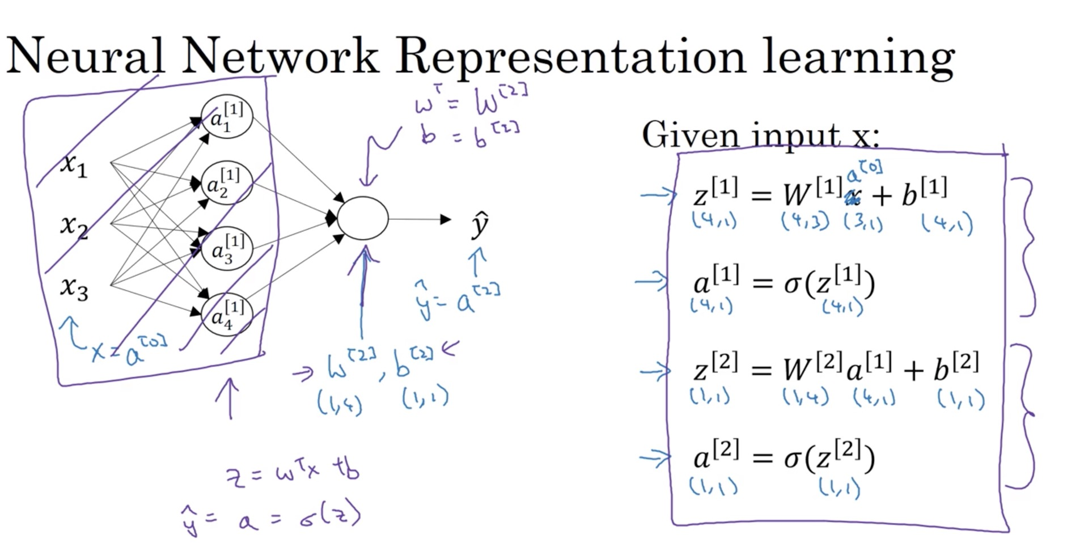

Slide 13
One hidden layer
Neural Network
Vectorizing across
multiple examples

Slide 14
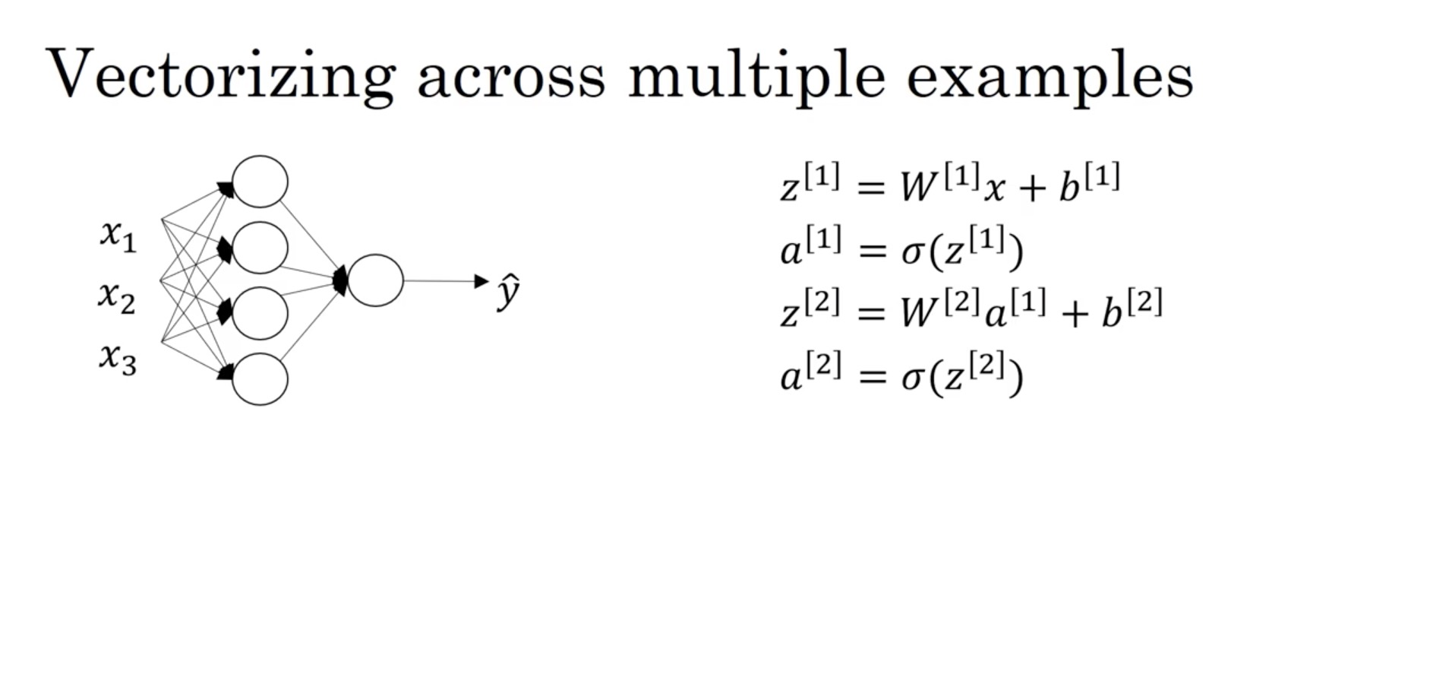

Slide 15
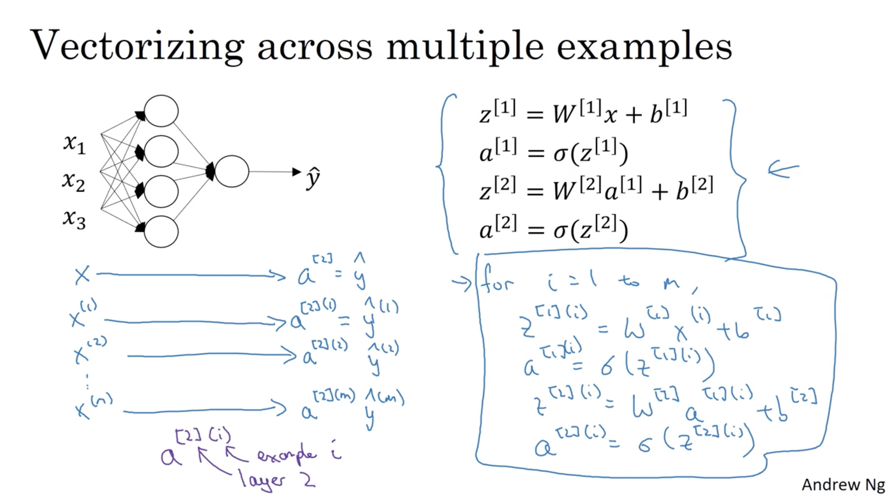

Slide 16
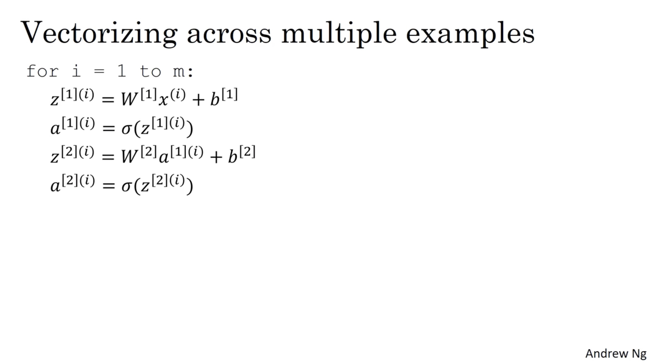

Slide 17
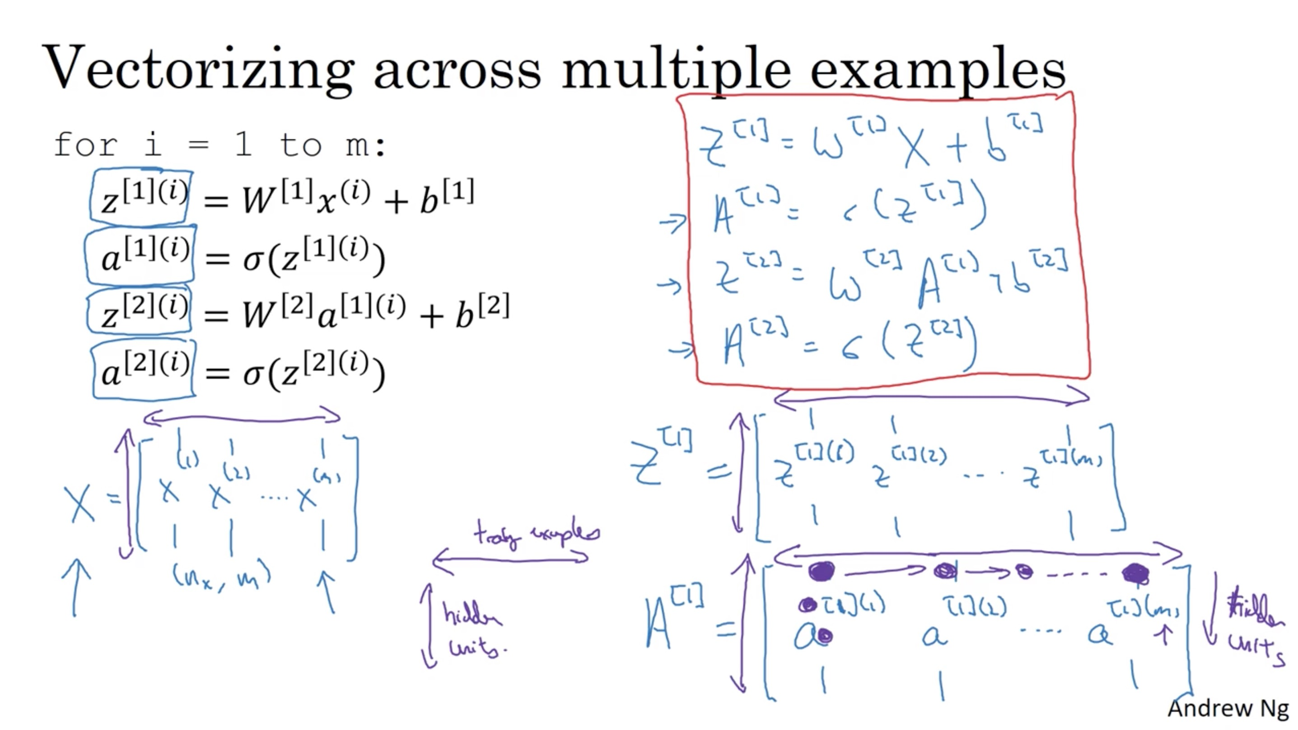

Slide 18
One hidden layer
Neural Network
Explanation
for vectorized
implementation

Slide 19
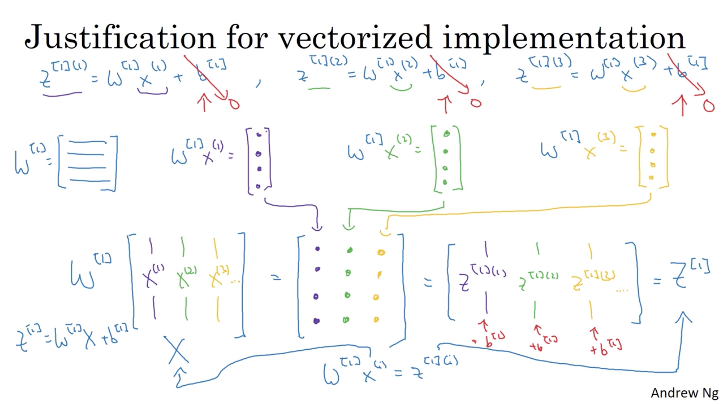

Slide 20
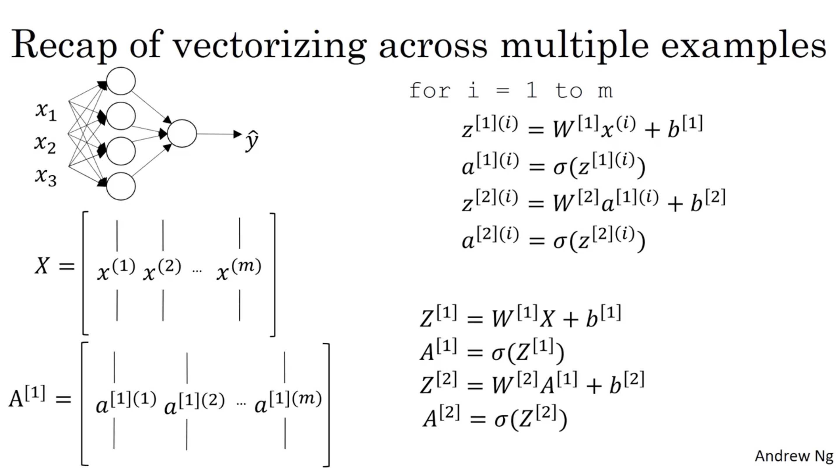

Slide 21
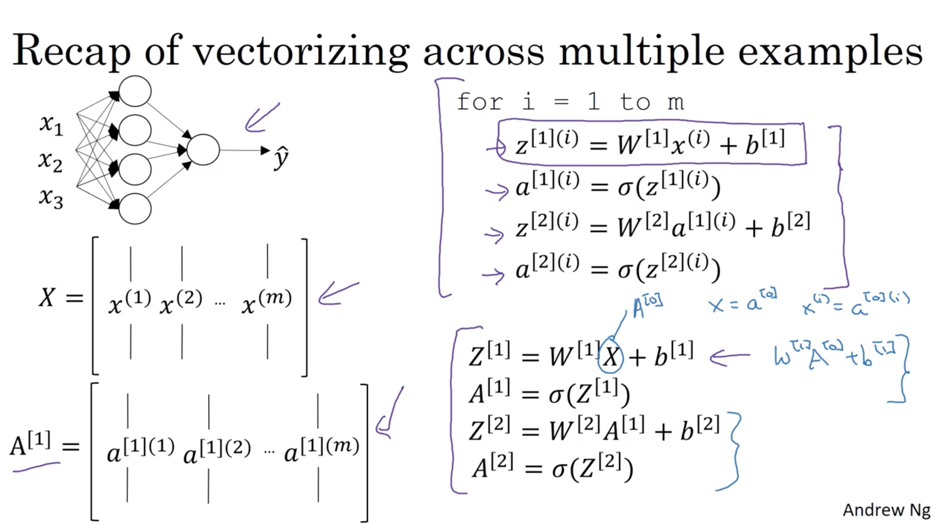

Slide 22
One hidden layer
Neural Network
Activation functions

Slide 23
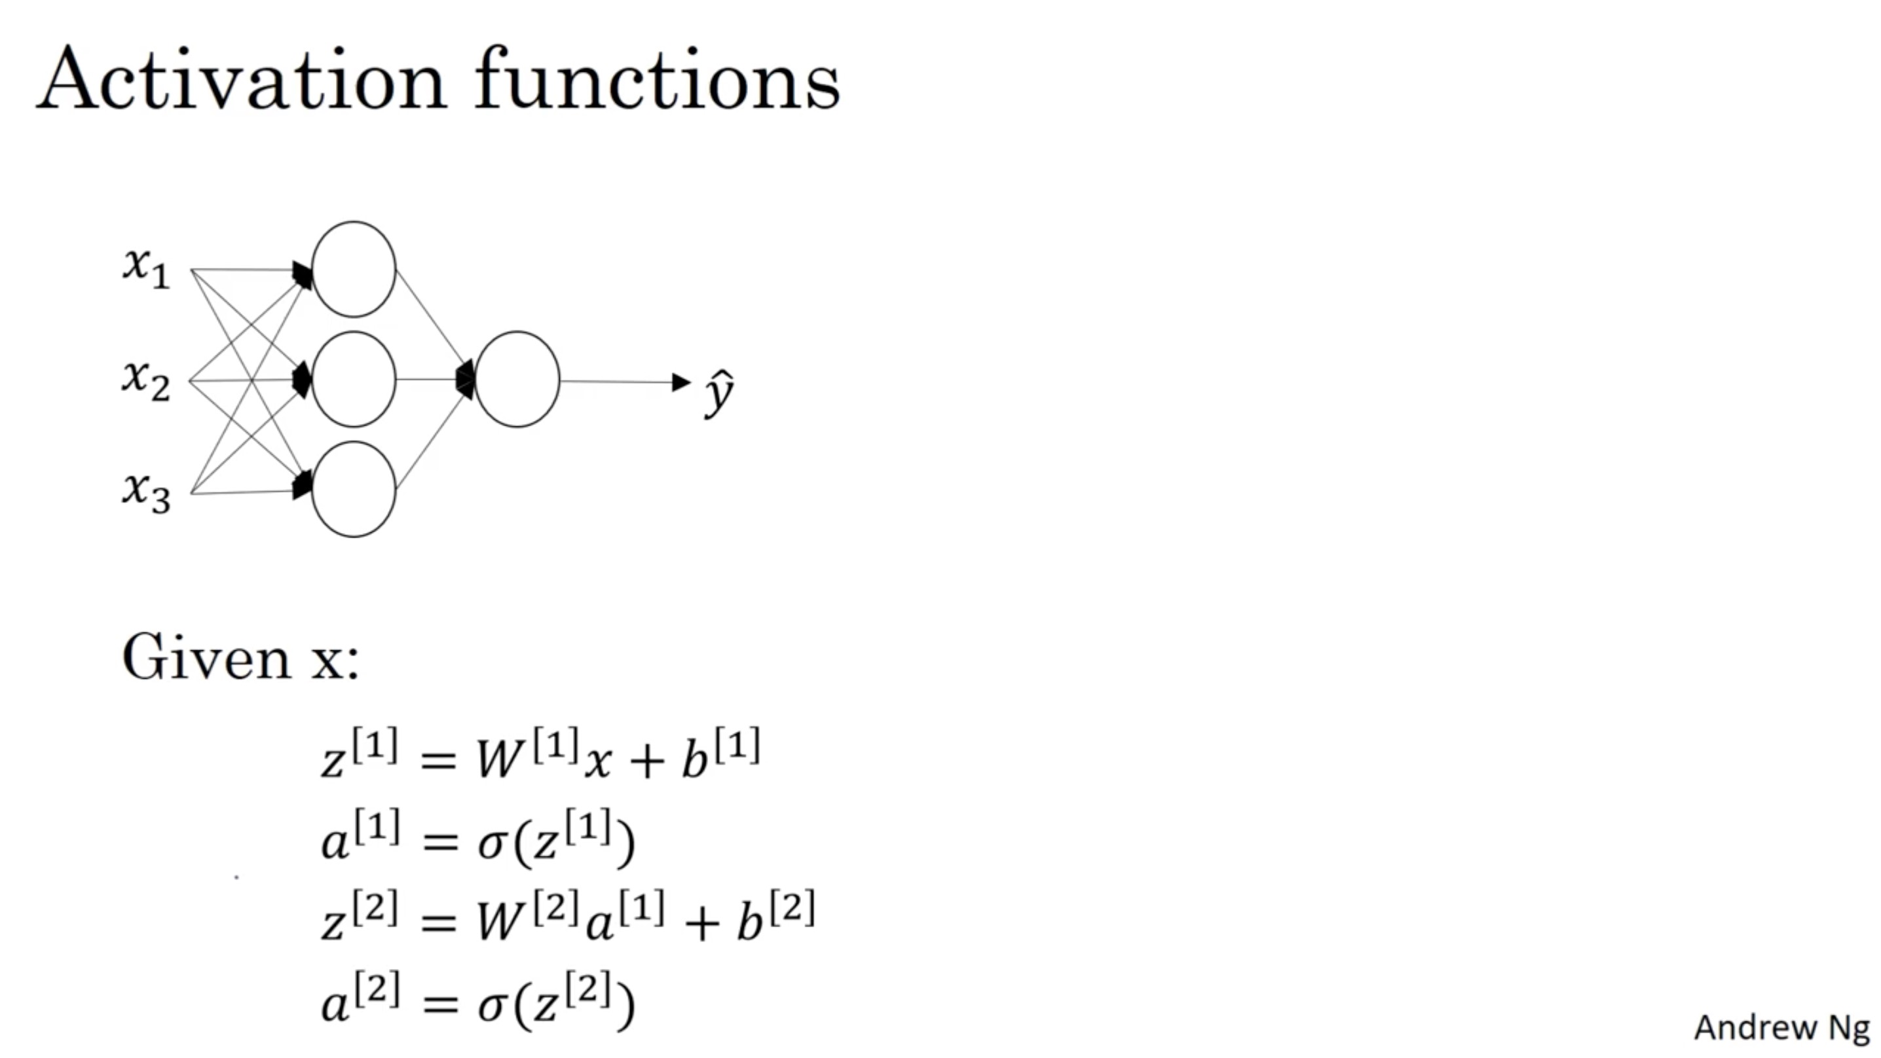

Slide 24
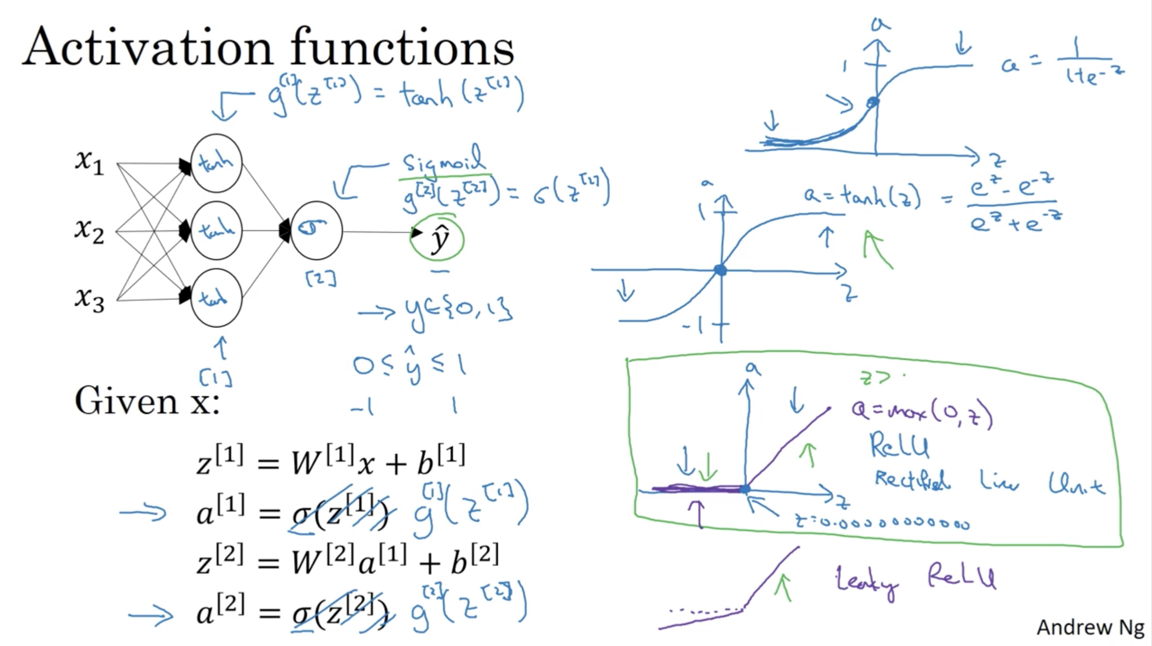

Slide 25
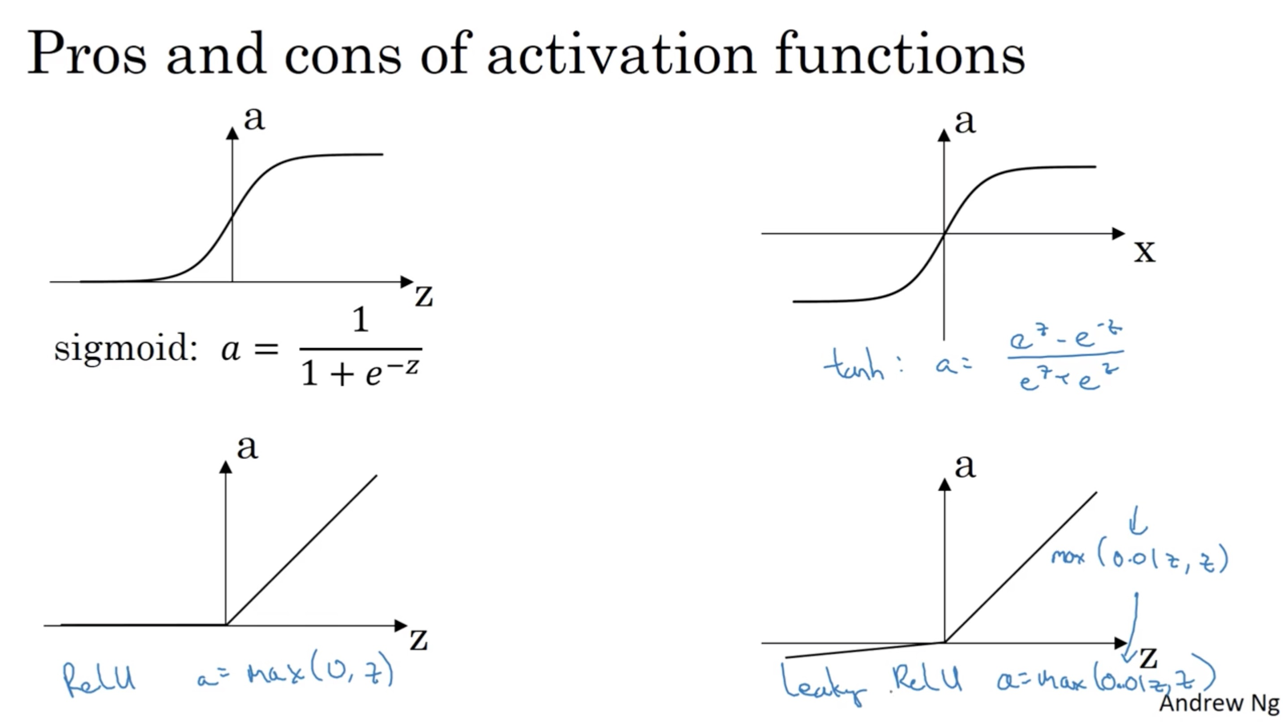

Slide 26
One hidden layer
Neural Network
Why do you
need non-linear
activation functions?

Slide 27
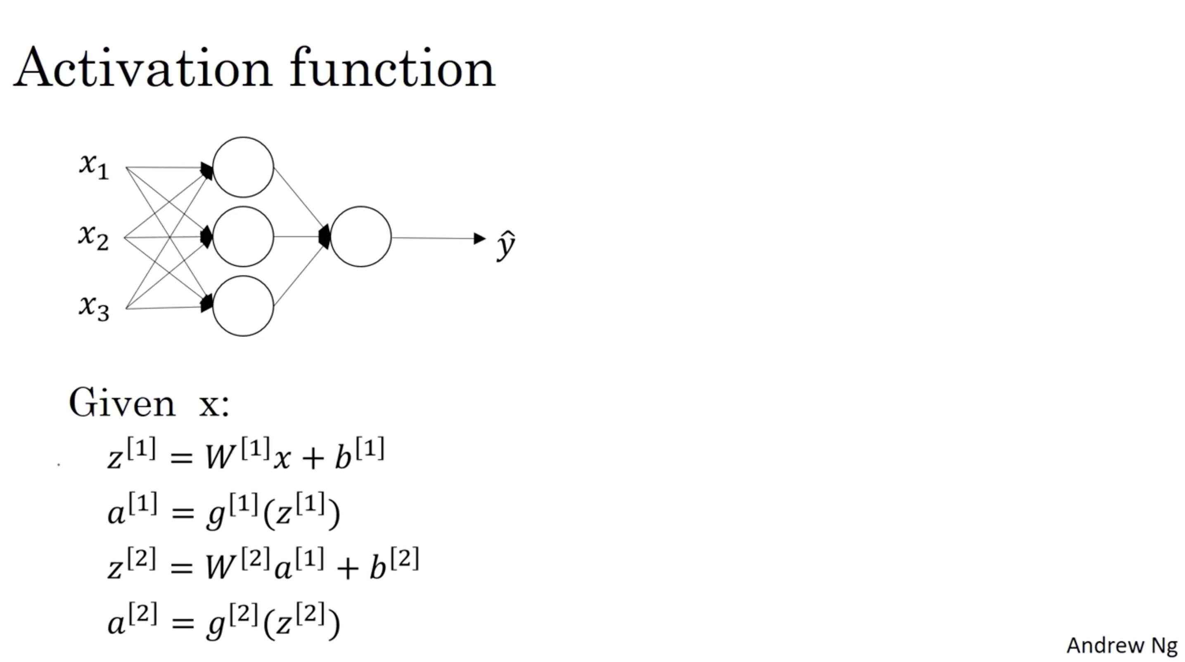

Slide 28
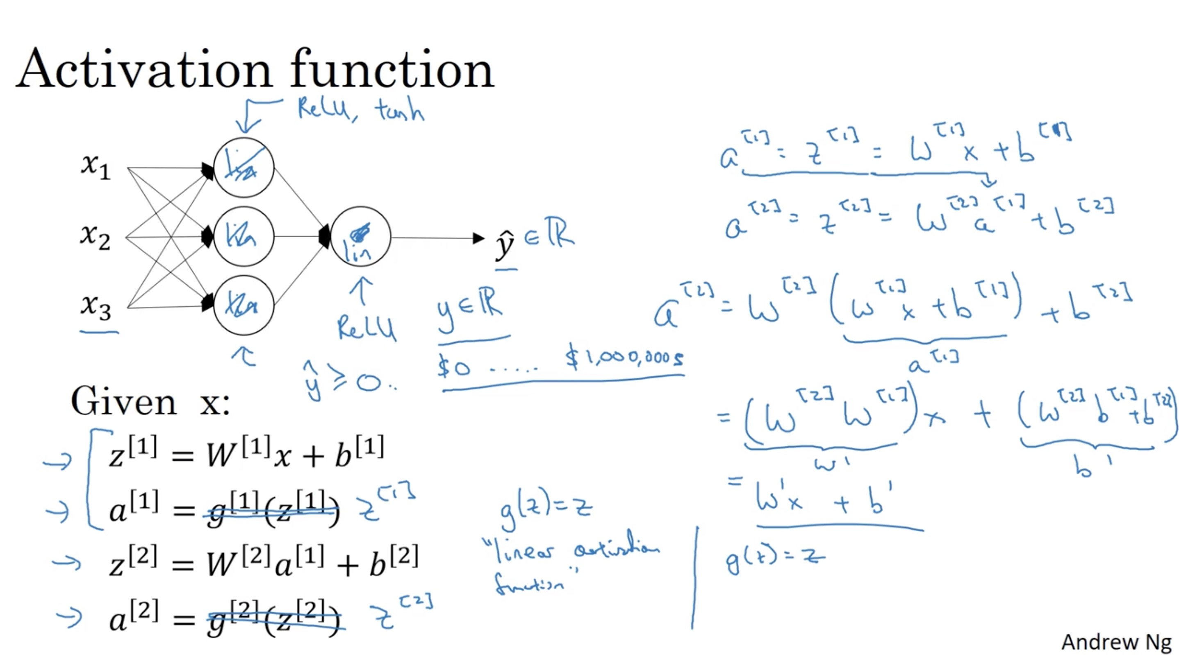

Slide 29
One hidden layer
Neural Network
Derivatives of
activation functions

Slide 30
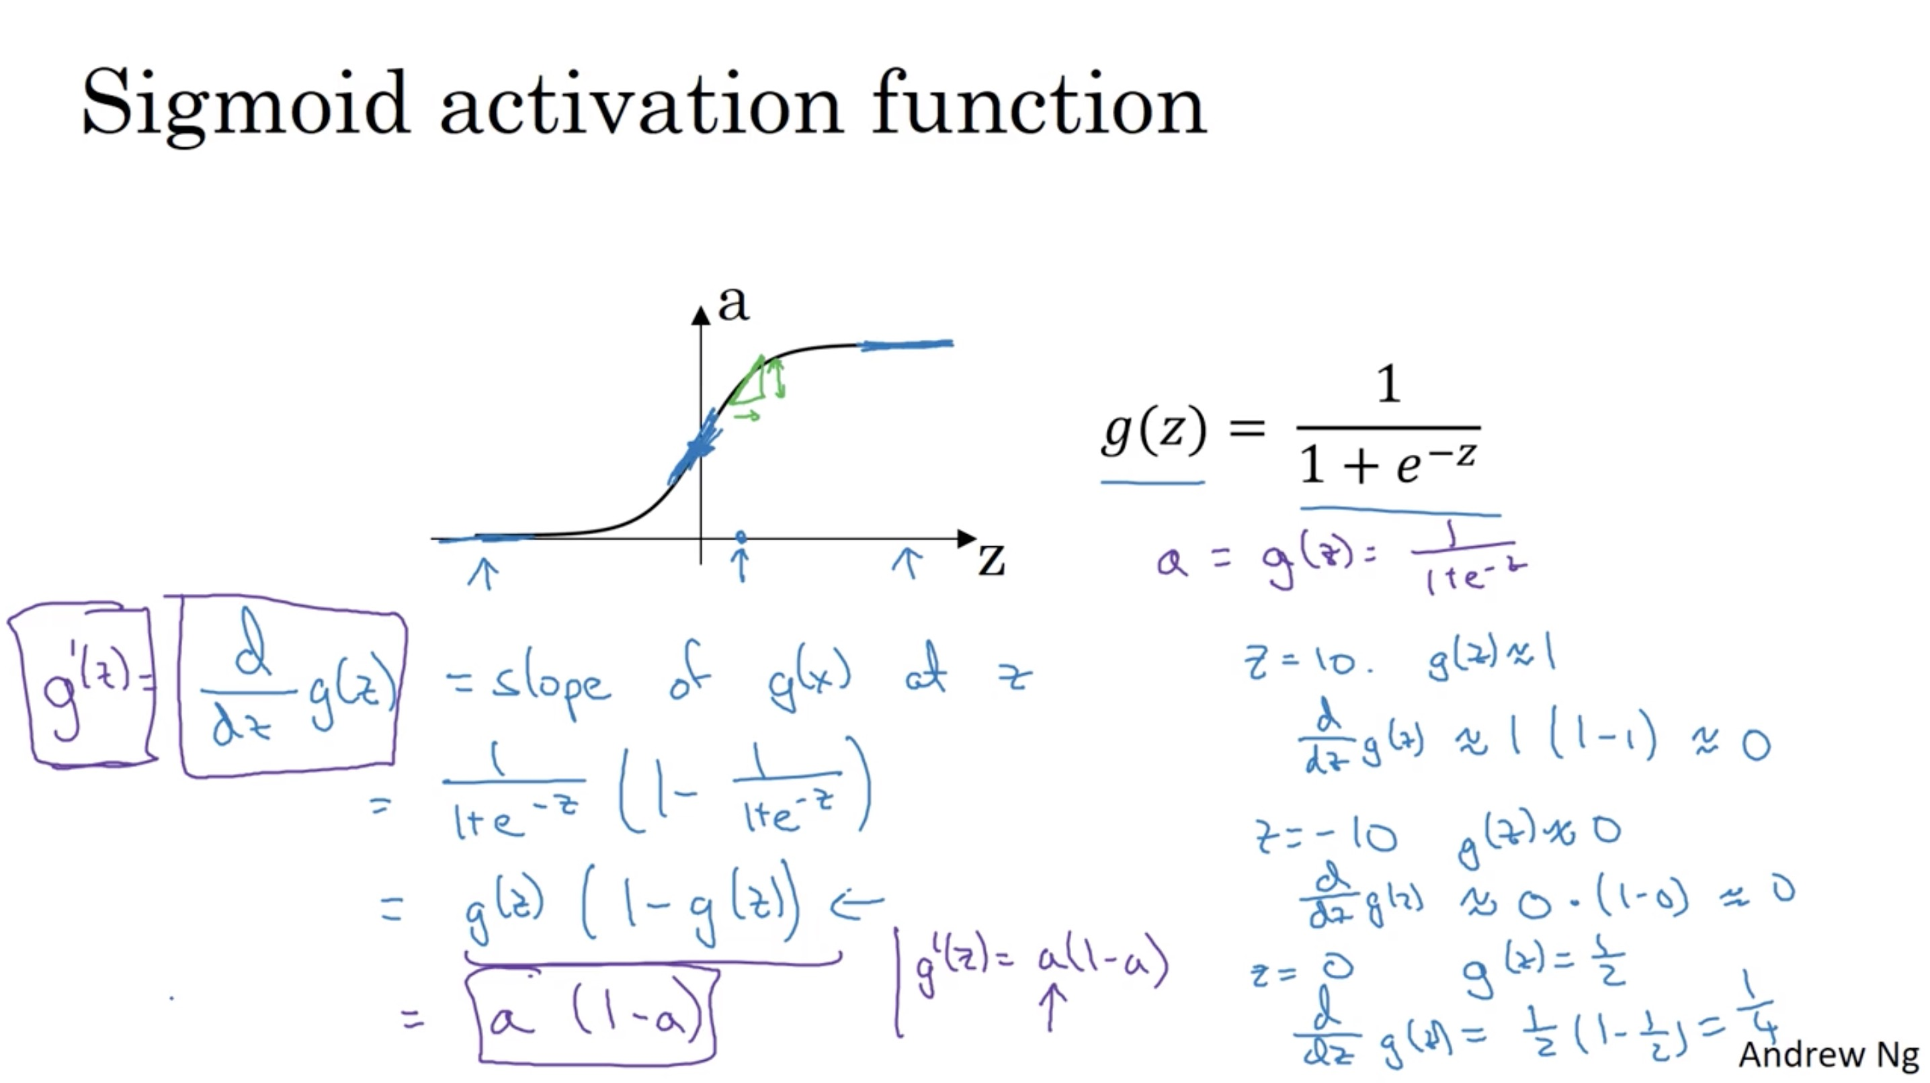

Slide 31
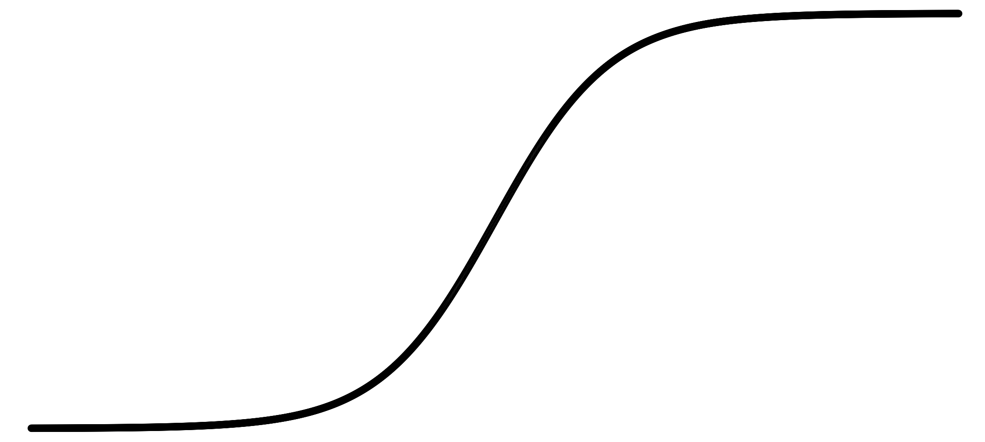
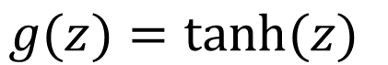
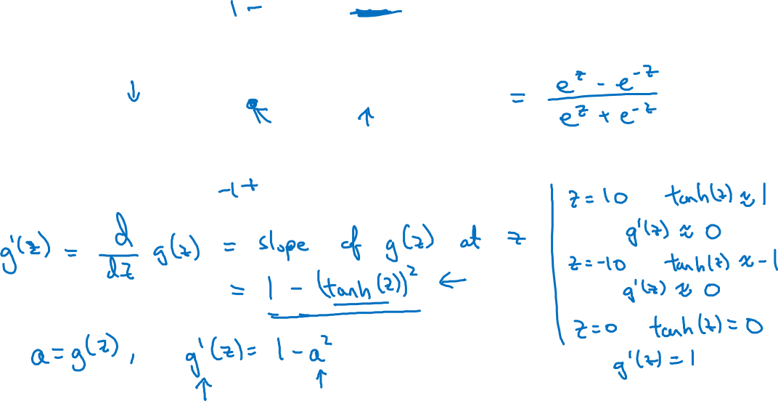
Tanh activation function
a
$$g(z)=tanh(z){ }$$
z

Slide 32
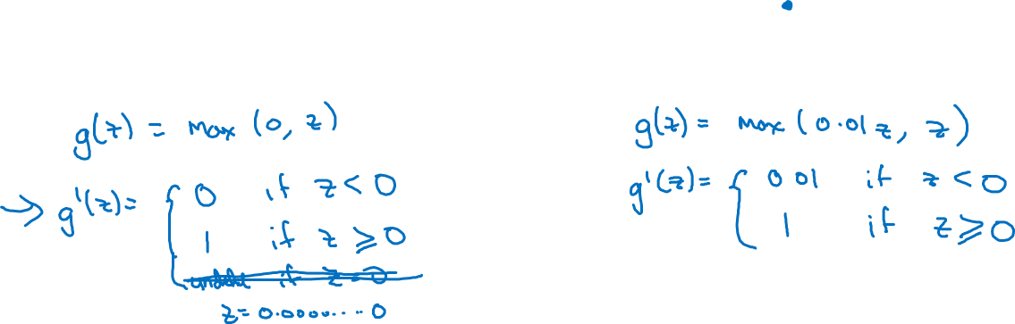
ReLU and Leaky ReLU
a
a
z
z
ReLU
Leaky ReLU

Slide 33
One hidden layer
Neural Network
Gradient descent for
neural networks

Slide 34
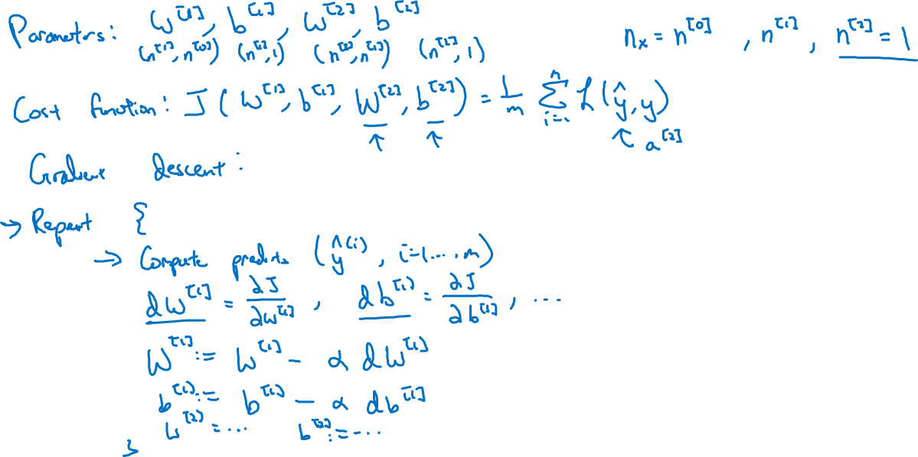
Gradient descent for neural networks

Slide 35
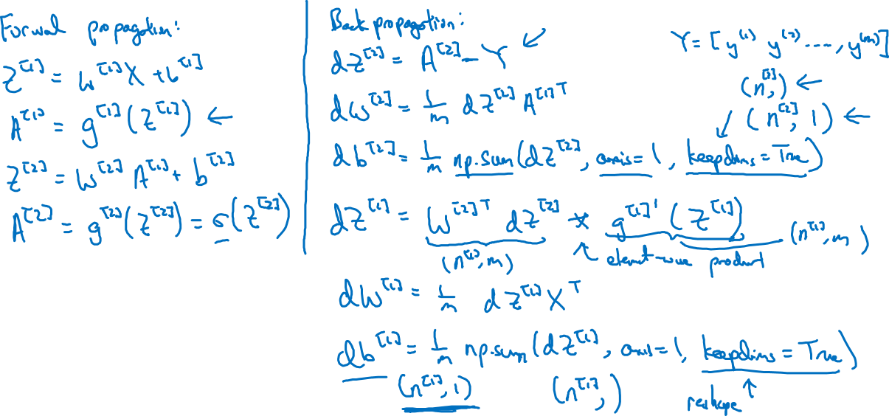
Formulas for computing derivatives

Slide 36
One hidden layer
Neural Network
Backpropagation
intuition (Optional)

Slide 37
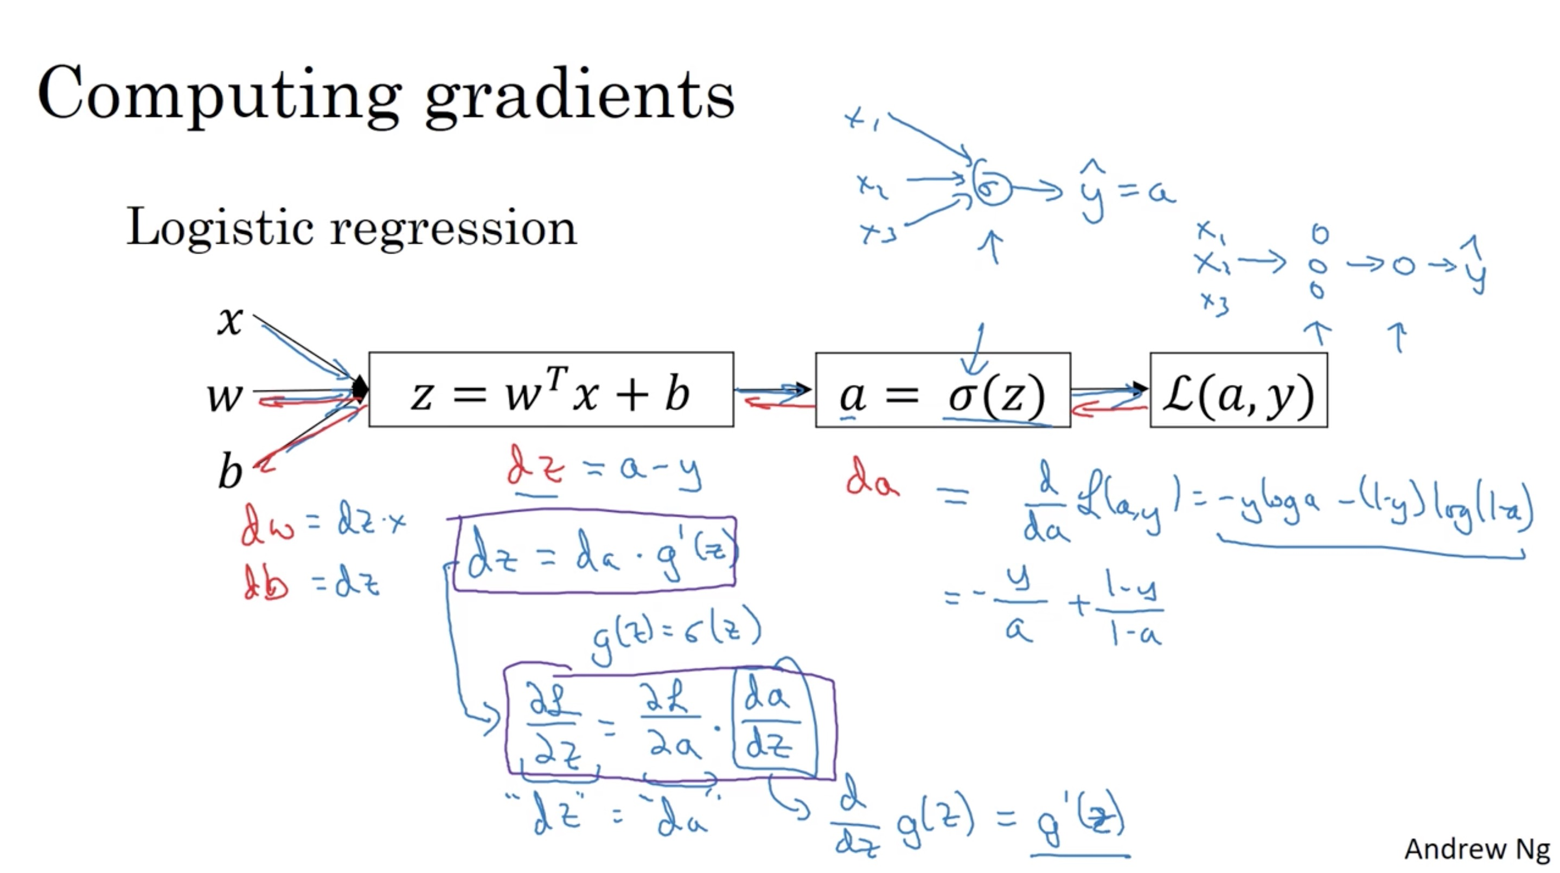

Slide 38
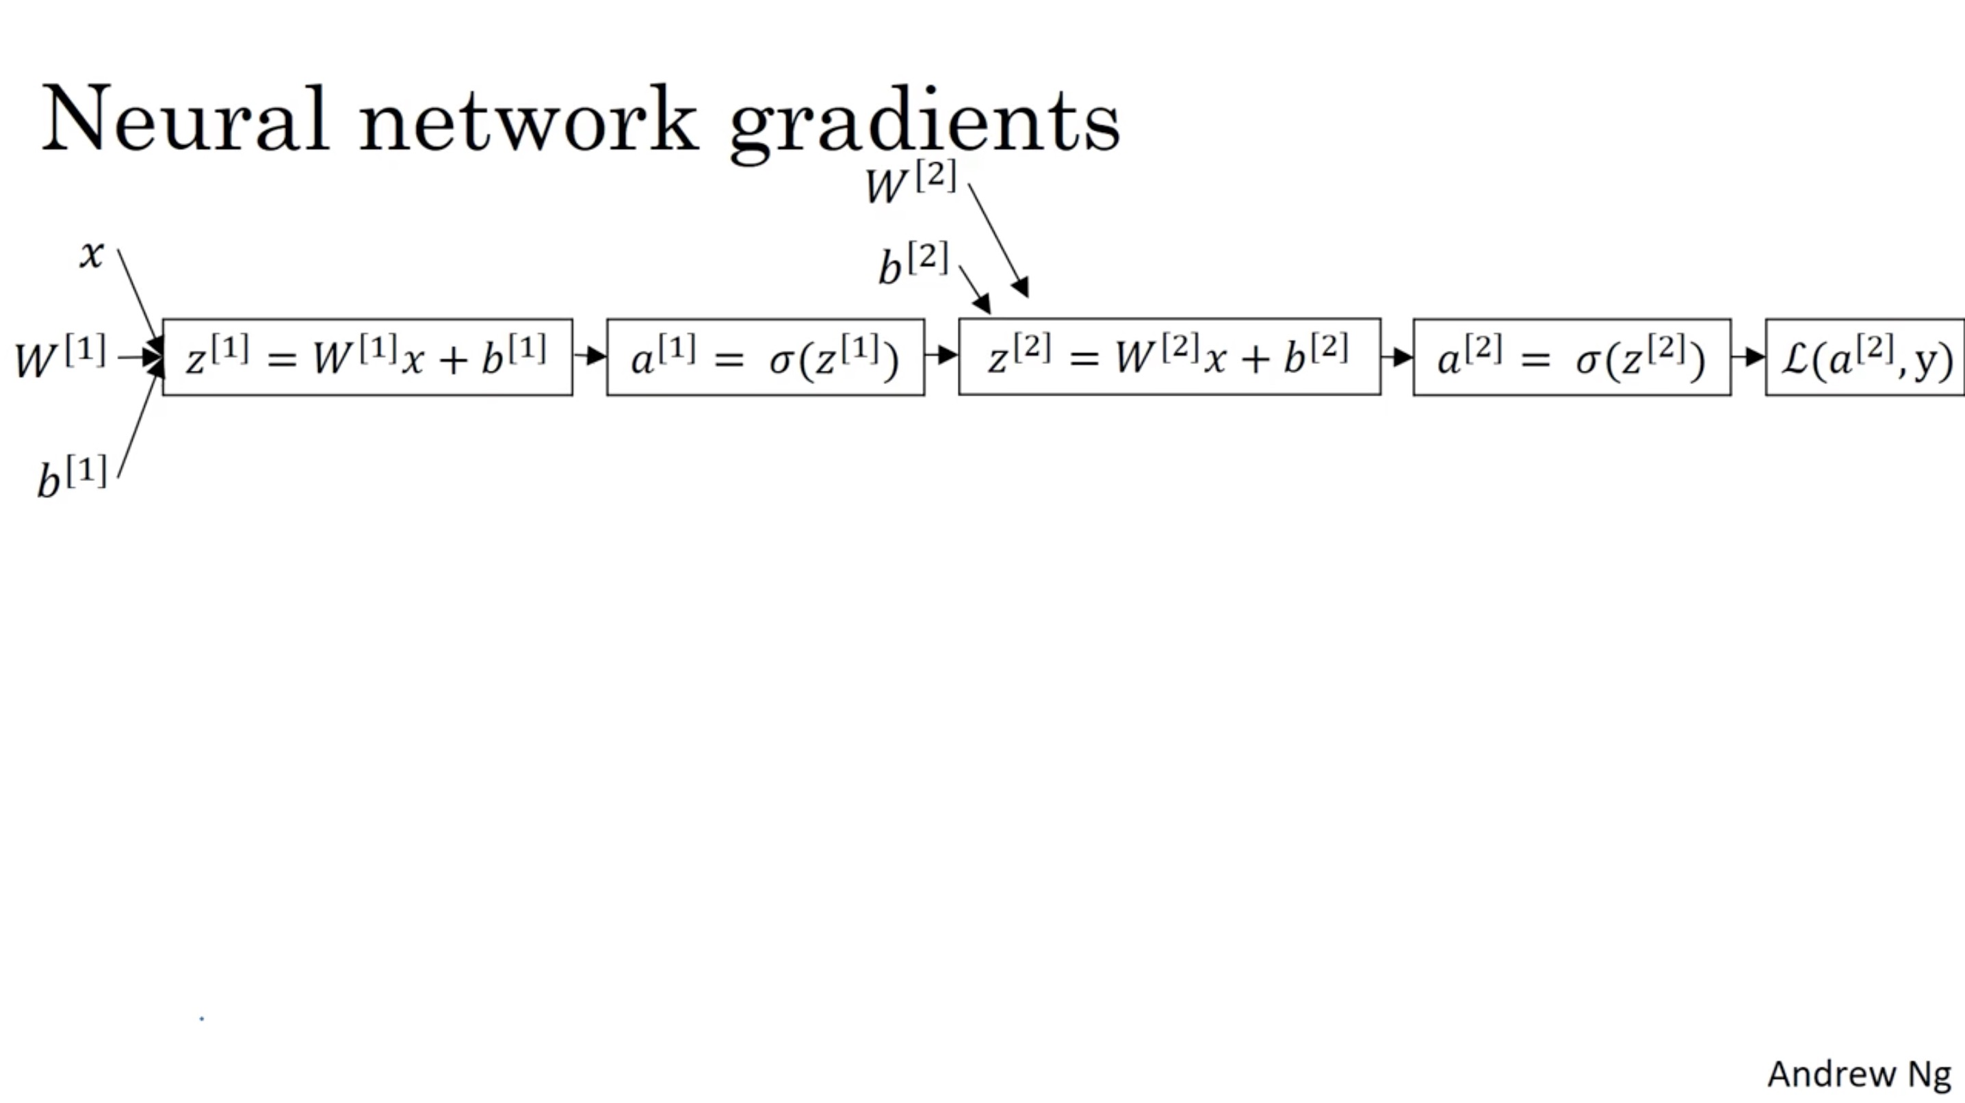

Slide 39
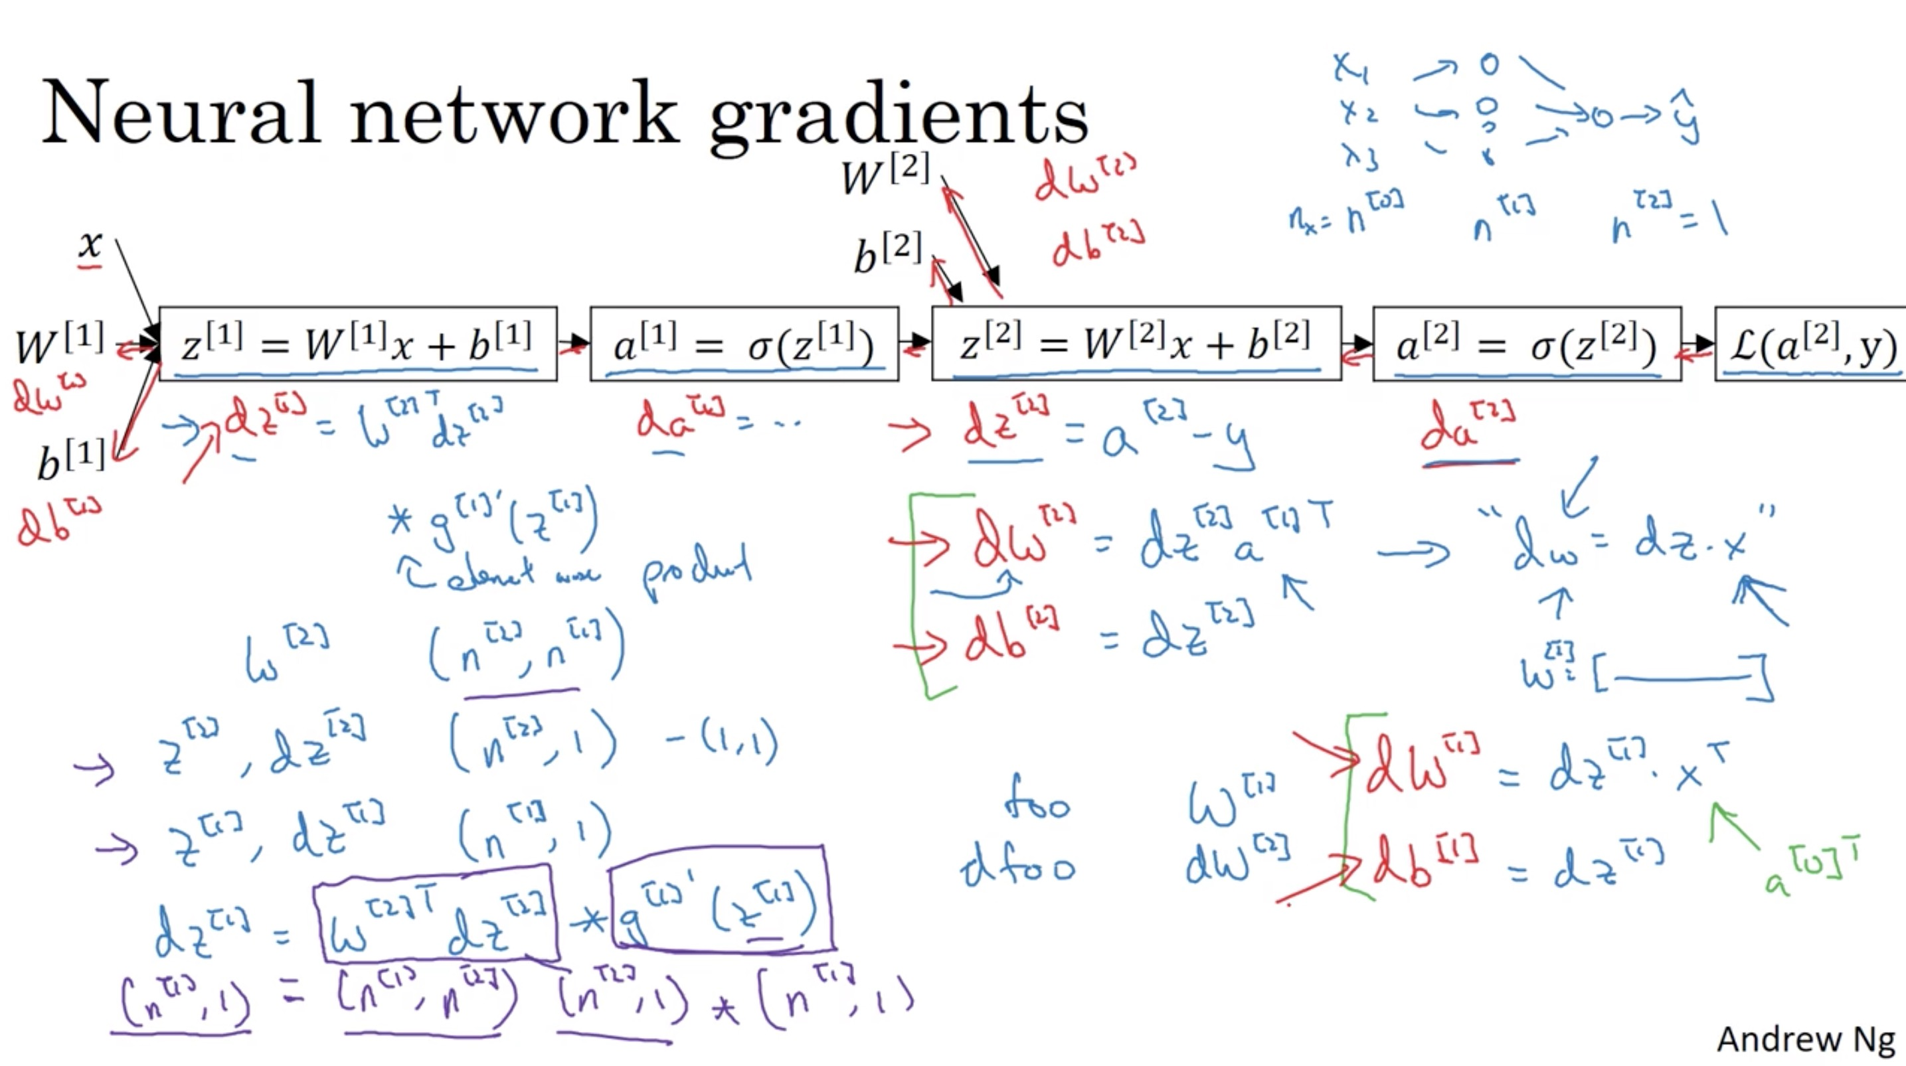

Slide 40
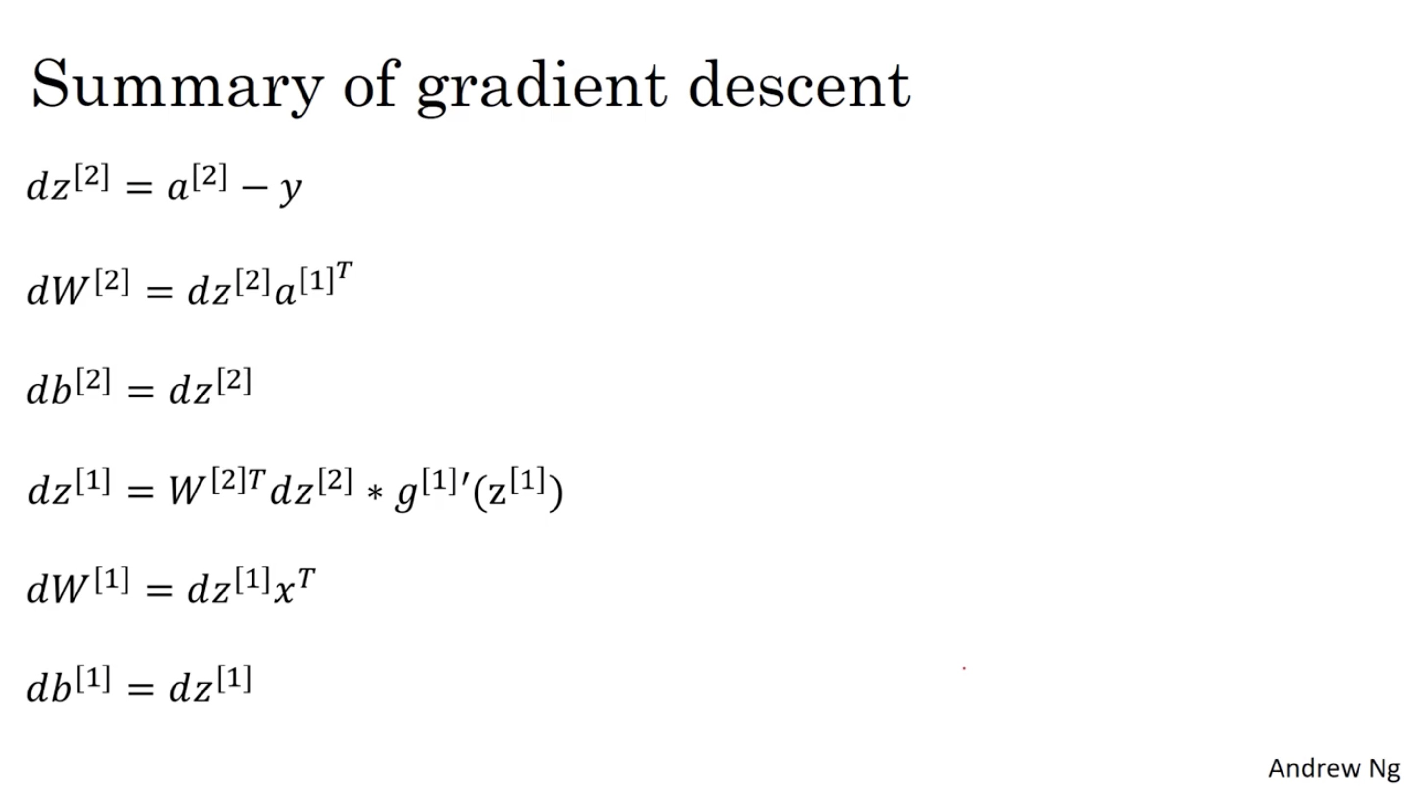

Slide 41
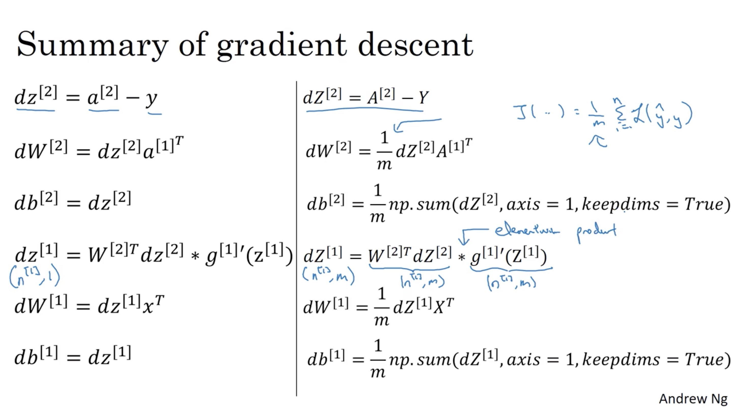

Slide 42
One hidden layer
Neural Network
Random Initialization

Slide 43
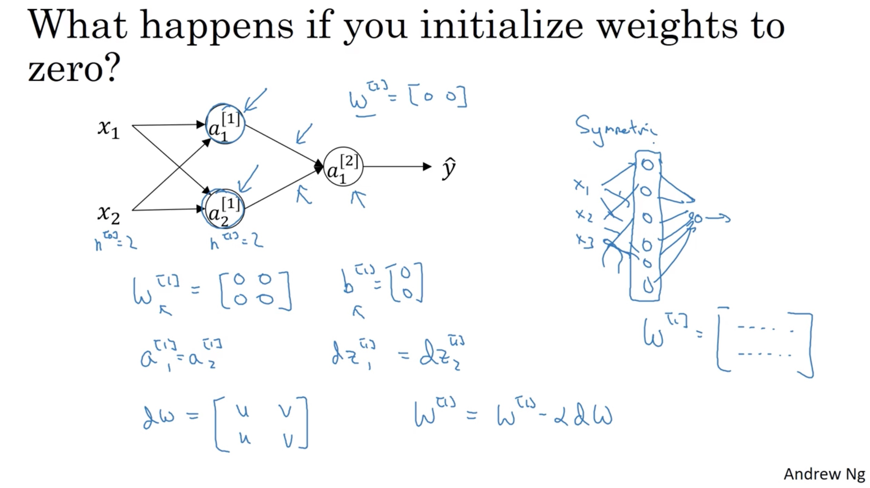

Slide 44
